Slide 1
Case Study: Global Wine War 2009
Brandon Bullock
Gabriel Esuola
James Jennings
Christa Thomas
Richard Zerbe

Slide 2
Primary Question
Could a winemaker finally capture 1% market share if its home country was strategically positioned?

Slide 3
Secondary Questions
What is France's ideal competitive position and what strategies lend to optimal performance?
What is South America's ideal competitive position and what strategies lend to optimal performance?
What is the United States' ideal competitive position and what strategies lend to optimal performance?
What is Italy's ideal competitive position and what strategies lend to optimal performance?
What is Australia's ideal competitive position and what strategies lend to optimal performance?

Slide 4
New World vs. Old World
Old World | New World
Countries
France, Italy, Spain, and Germany | Argentina, Chile, United States, Australia, and China
Characteristics
Rich in Tradition Heavy Gov’t involvement- regulations and subsidies High costs of production High Quality/ Higher Prices Home of 4 of the six largest wine markets by consumption Limited distribution and marketing | Innovation leaders in industry Utilize full Value Chain- excel in distribution and marketing Medium to low markets Moderate to Low Prices Relatively new to wine industry for both producers and consumers

Slide 5
Segments in the Wine Industry
 | Icon | Ultra Premium | Super Premium | Premium | Basic
Price Range | More than $50 | $20-50 | $10-20 | $5-10 | >$5
Consumer | Connoisseur | Wine lover | Experimenter | Experimenter | Price- Focused
Purchase driver | Image, style | Quality, Image | Brand, Quality | Price, Brand | Price
Retail Outlets | Winery, Boutique shops, Food service | Specialty Shop, good service | Better supermarket, Specialty shop | Supermarket | Supermarket, Discounter
Availability | Scarce | Scare | Sufficient | Large quantities | Surplus

Slide 6

France
What is France’s ideal competitive position
and what strategies lend to optimal
performance?

Slide 7
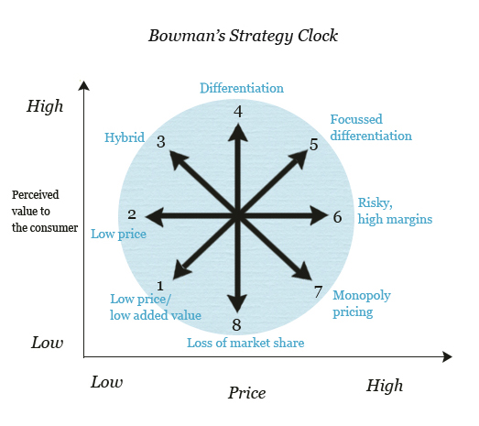
France
Generic Strategy Clock
Formerly successful: | Why:
Vineyards grow grapes: Large producers made wine Small producers sold grapes to merchants by volume Merchants blend, bottle, and distribute | Customer base was spread out and small. Although using merchants fragmented the value chain, producers needed logistical help, and customers were not price-conscious yet
Focus was on large volume production, not quality | Wine became culturally and economically significant. In 1750’s = 2nd largest export
The extent of differentiation was a governmental classification system of quality based on rules and controls | The wine market was complex and highly fragmented. The classifications helped customers understand purchases
Grand Strategies
 | Existing Products | New Products
Existing Market | Market Penetration or Consolidation | Product Development
New Market | Market Development | Diversification
New Industry
Little Competition
First Mover Advantage
WEAK
STRONG
Competitive Position:

Slide 8
Changes to the Industry
Chronological Order of Innovations |  | Applicable to Old World | Applicable to New World | Effect on France
Late 1700's | Mass production of bottles and cork stopper. Pasteurization | X | X | Dramatically improved production capacity and enabled longer storage. Birthed the global wine market.
1800's | Vineyard horses & planting in rows | X | X | Increased efficiency and competitiveness
1850's | Classification system for wines | X | X | Allowed differentiation and consumer understanding
1880's | Phylloxera-resistant vines | X | X | Improved health and life of vines
1900's | Controlled drip irrigation (enables use of marginal land |  | X | Less competitive
late 1900's | Mechanical harvesters and pruners (reduced labor costs) |  | X | Less competitive
late 1900's | Night harvesting (maximizes grape sugars) |  | X | Less competitive
late 1900's | Modern trellis systems (vineyards 2x denser) |  | X | Less competitive
late 1900's | Fertilizers and pruning methods (increased harvest yield and improved grape flavor) |  | X | Less competitive
late 1900's | Marketing specific consumers |  | X | Less competitive
Late 1900's | Producers own and control entire value chain |  | X | Less competitive
1990's | Reverse osmosis (color and taste enrichment) |  | X | Less competitive
1990's | Incorporate stainless steel barrels, computers, and oak chips in fermentation/aging process |  | X | Less competitive
1990's | Packaging changes (decreased shipping costs and facilitated storage) |  | X | Less competitive
- Lack unique resources
- Lack core competencies
- Fragmented value chain
- Inefficient
- Incoherent strategies
Risk of the Kodak complex
WEAK
STRONG
Competitive Position:

Slide 9
Strategy Recommendation
Target Icon/Ultra Premium Wines!
Directional Matrix: Icon/
Ultra Premium Wines
Icon/Ultra Premium Wine Profitability
France’s Potential Competitive Capability |  | Unattractive | Average | Attractive
 | Weak
 | Average
 | Strong
SWOT: Icon/UP Wine Production in France
Strengths
Weaknesses
Icon and UP Wines
French producers have experience French wine is branded as high end already due to the French’s commitment to technique and high-price | Asset allocation is not focused; many vineyards are dedicated to below-premium wines Fragmented value chain and distribution processes
Climate is conducive to growing premium grapes Grape-growing restrictions are lightening Regulation environment fosters the growth of premium over basic | New World producers can often produce high end wines at lower costs/higher margins Consumer purchasing power may not be great enough to afford premium wines
Porter’s 5 Forces: Icon/ Ultra Premium Wines
Intensity of Rivalry | Medium Force... Spain and Italy are strong rivals; New World producers are less threatening.
Bargaining Power of Suppliers | Benign… suppliers can be easily replaced; moreover, cost increases can be passed down to the customer
Bargaining Power of Buyers | Benign… there exists no major customer in this industry. Buyers can exercise power only by switching brands.
Threat of New Entrants | Medium Force… the barriers to entry are moderate. New entrants are disadvantaged by start-up costs and lack of brand image.
Threat of Substitutions | Strong Force… customers can substitute for less-expensive wines or alternative drinks easily.
Opportunities
Threats
WEAK
STRONG
Potential Competitive Position:

Slide 10
Necessary Changes in France’s Competitive Position:
Value Chain
Wine Producer
Independent Distributor
Independent Distributor
Independent Distributor
Retailer/
Customer
“A long, multilevel value chain, with service providers in many of the links lacking either the scale or expertise to operate efficiently”
Engage FORWARD VERTICAL INTEGRATION to Achieve this Value Chain:
Wine Producer + owned/controlled distributor
Wine Producer
Independent Distributor
Independent Distributor
Independent Distributor
Retailer/
Customer
Low Cost
High Cost
High Scope
Recommended
Necessary Generic Strategy
Original
Low Scope

Slide 11
Necessary Changes in France’s Competitive Position:
1.0
+
Recommended
Icon/Ultra Premium Wine in France
Industry Growth
Boston Consulting Group Matrix
5%
Increase Relative Market Share!
_
+
Relative
Market Share
_
 | Existing Products | New Products
Existing Market | Market Penetration or Consolidation | Product Development
New Market | Market Development | Diversification
Grand Strategy
If the product focus is on Icon/Ultra Premium Wines, all Grand Strategies can be used

Slide 12
Necessary Changes in France’s Competitive Position:
Unique Resources & Core Competencies
For Icon/Ultra Premium Wine Production in France
 | Unique Resources | Relative Significance (scale: 1 – 5) | Core Competencies | Relative Significance (scale: 1 – 5)
Existing | Strict Regulation Environment | 2 | Complying with Regulations | 3
 | Pre-established image as a high end wine producer | 4 | Producing high quality, expensive wines | 5
 | Experience | 5 | Leveraging experience and expertise | 5
Recommended | Condensed, efficient value chain | 5 | Squeezing value out of the value chain’s components | 4
 | Strong brand image | 5 | Ability to conduct useful market research | 4
 | High quality grapes and plots of land | 3 | Acquiring highest quality resources | 4
By adjusting the Value Chain, Strategies, and Unique Resources and Core Competencies France may be more competitively positioned to obtain at least 1% market share…

Slide 13

Italy
What is Italy’s ideal competitive position
and what strategies lend to optimal
performance?

Slide 14
Italy’s Current Conditions
Grape Production 1996-2006 By Country
World Rank | Country | Production 2006 (US Tons) | % Change 1996-2006
1st | Italy | 8,700 | (12.25%)
2nd | France | 7,700 | (7.17%)
3rd | Spain | 7,500 | 22.41%
4th | United States | 6,417 | (1.47%)
5th | China | 6,100 | 125.61%
Italy is the global leader in wine production and exports (by volume) and is also the global leader in grape production
Italy is home to 3 of the top 20 wine brands by volume
As a high volume producer Italy has found itself operating in the moderate- to-low cost end of the wine industry.
The wine industry is a crucial part of Italy’s economy and culture.

Slide 15
Current Industry Trends
Segmentation and Growth Trends
Premium segments are growing as wine consumption increases in US and UK driving higher priced wine sales
Mature Markets such as France, Italy, Spain, & Germany are still top 6 markets despite a drop in consumption
New markets without established wine palates tend to prefer the Premium and Super Premium segments
Country | Increased Consumption
Russia | 74.89%
Canada | 45.65%
China | 39.5%
United Kingdom | 17.99%
United States | 13.67%
5 Forces- Premium
Buyers-Medium: retailers control sale of majority of segment
Rivalry-High: price and branding
New Entry-High: branding not as significant
Suppliers- Low: Excess supply in EU
Substitutes-Medium: many low cost alcohol substitutes
 | Icon | Ultra Premium | Super Premium | Premium | Basic
Market Trend | Little Growth | Little Growth | Growing | Growing | Decreasing
Competition | Limited | Gradually Increasing | Increasing (brand and quality/price ratio) | Fierce (brand and price) | Price
Volume Market Share | 1% | 5% | 10% | 34% | 50%
Availability | Scarce | Scarce | Sufficient | Large quantities | Surplus

Slide 16
Strategy Recommendations
Generic Strategy
Target the Global Premium/ Super Premium Segments
Competitive Position
 | Low Cost | High Cost
Broad Scope
Narrow Scope
Italy’s history and resources allow it to be the leading wine producer in the world.
Heavy volume production doesn’t allow for a high end differentiated product due to it only being 6% of entire industry.
Global Premium/SP Markets
Competitive Scope
Core Competencies/Unique Resources
Resources | Rank (1-5 scale)
Experience (Old World) | 3
Volume Production | 5
Heavy Supply (Prestige) | 4
Proximity to Largest Markets | 4
Italy already has a history of being the leader in wine production
Narrowing down to two segments will allow Italy to focus in on core consumers
Being the largest exporter in the world allows to build on current distribution networks worldwide

Slide 17
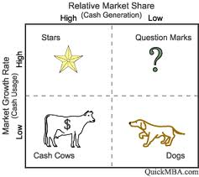

Italy’s Competitive Strategy
Directional Matrix
BCG Matrix
Premium/SP Wine Profitability
Italy’s Potential Competitive Capability |  | Unattractive | Average | Attractive
 | Weak
 | Average
 | Strong
Premium/SP Wines
Premium/SP Segment
Grand Strategy
Ansoff’s Matrix | Existing Products | New Products
Existing Market | Market Penetration or Consolidation | Product Development
New Market | Market Development | Diversification
Italy is the largest volume imported wine in the US. Penetrate that growing market and consolidate in saturated European countries.
China, Canada, and Russia will be areas for market development as wine consumption as skyrocketed in each.

Slide 18
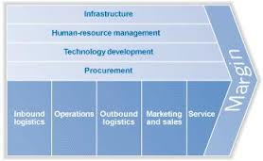
Additional Recommendations
Value Chain
Grape Grower
Wine Producer
Distribution
Retailers
Consumers
Backward Vertical Integration
-Global distribution(forward integration)of high volume of product is extremely costly
-Backward integration allows wine producers to control suppliers and efficiently lower the variable costs per bottle increasing margins on heavy volume
Both technology development and operations are areas in the value chain where efficiency can be improved thus cutting costs.
Marketing and sales will be crucial in working with distributers and retailers to leverage more cooperation and sales.

Slide 19

South America
What is South America’s ideal competitive position
and what strategies lend to optimal
performance?

Slide 20
South American Wines
Chilean & Argentinian
Grape Production 1996-2006 By Country
World Rank | Country | Production 1996-2000 (US Tons) | Production 2006 (US Tons) | % Change 1996-2006
1st | Italy | 9,914 | 8,700 | (12.25%)
2nd | France | 8.295 | 7,700 | (7.17%)
3rd | Spain | 6,127 | 7,500 | 22.41%
5th | China | 2,704 | 6,100 | 125.61%
8th | Argentina | 2,456 | 2,700 | 9.94%
10th | Chile | 1,827 | 2,200 | 20.42%
Notes:
Represent around 1/3 of the production from the 3 highest producing countries, all old world wine producers
Enormous growth in production for China, will talk about later for low-price segment competition
In the future, we can expect old world production to continue to slow because of ultra (5%), super (10%), and premium (34%)
2007 French encouraged farmers to uproot 200,000 hectares (hek-tar) Italy and Spain may follow soon to decrease supply

Slide 21
Wine Consumption by Country
Top 3 Countries in Wine Consumption
World Rank | Country | Consumption 2002 (Hectoliters) | Consumption 2006 (Hectoliters) | % Change
1st | France | 34,820 | 32,800 | (5.8%)
2nd | Italy | 27,709 | 27,300 | (1.48%)
3rd | United States | 23,650 | 26,883 | 13.67%
Notes:
Small but significant in France and Italy as they are 1 and 2 in consumption
Shaper decline for Italy while France experiences small decline year to year
Emerging Markets – US, China, UK, and Russia
All have experienced growth in this 5 year period
UK (18%) and US (14%) steady increases. Significant growth Russia (75%) and China (40%)
Larger scale 1966 to 2005, per capita annual consumption in the United Kingdom rose from 3 to 20 liters
During the same period per capita annual consumption in France/Italy was around 110 to 120 liters; by 2005 it was about 50 litres

Slide 22
South American Wines PESTEL Analysis
 | Opportunities | Importance | Threats | Importance
Political | NA |  | N/A
Economic | Low labor costs in South America Low cost of land | High | Low labor costs in Asia Highly competitive low-price segment | High
Social | Worldwide wine consumption increase of 6.8% from 2002-2006 Wine adopted as Chilean and Argentinian culture. | High | Consumption is starting to trend higher for super, ultra, and premium wines. | Moderate
Technological | New developments lower cost and increase quality | Moderate | Technology from U.S. and Australia may take longer to reach South America. | Moderate
Environmental | Ideal climate and soil for growing grapes | Moderate | N/A
Legal | 2005 US Supreme Court ruling triggered a series of state and federal regulation challenges that began to open up the US distribution system. | Moderate | N/A
Notes:
ECONOMIC
*Cost of pruning an acre in 2008 US and France $350, highly mechanized Australia $120 ,or in low labor cost Chile $75
*As we saw earlier China #5 spot with 125% growth in grape production from 1996-2006
SOCIAL
*Due in large part to the emerging markets we just looked at, consumption increase up 6.8% over 5 years
U.K. offered a more attractive market (the €3-5 segment accounted for 57% of sales) US 11 billion in 1993 to 30 billion in 2007
*Early on in the 1960s, adopted wine into their own cultures 80 liters in Argentina and 50 liters in Chile
*Almost all countries have increased demand for higher quality wine. jug wine sales in the United States declined from 800 million to 600 million liters, while consumption of premium wines increased from 150 million to 600 million liters. Premium & Super premium have 40% of global market, 50% in younger markets. However basic wine under $5 still is 50% of global market.
TECHNOLOGICAL
*Reverse osmosis, drip irrigation, stainless steel barrel aging, trellis, fertilizing, night harvesting, new pruning methods
*Old world wineries initially restricted in taking part for many of these new approachs.
ENVIRONMENTAL
*Lots of land cheap, good soil, and sunny climate
LEGAL
*US initially had regulatory strictures differ state-by-state , and a complex three-tier distribution system that forced all sales to pass through state-licensed wholesalers.

Slide 23
Low Cost Wine - Five Forces
Low Cost Wine Segment
Threat of New Competition | Among the five tiered classification for wine cost, the basic segment could be attract for new entrants. | High
Threat of Substitute Products/Services | Creating a low cost wine could be much easier and cost effective for many wineries. Large existing companies could also develop low cost brands. | Moderate
Bargaining Power of Buyers | As consumer’s tastes and preferences change. The demand for higher quality wines may continue to grow. | High
Bargaining Power of Suppliers | Many new world wineries control their product from the grapes to the store shelves. | Low
Intensity of Competing Products | Competition among U.S., Australian, South American and eventually Chinese low cost wines. | High

Slide 24
South America SWOT Analysis
Strengths Low production costs, cheaper than Australia. Concha y Toro, 4th among top wine brands at 11 million cases in 2007. Control over value chain | Opportunities Low labor cost in South America. 6.8% global wine consumption growth from 2002 to 2006. New technological developments Ideal climate and soil for growing grapes. Better access to U.S. wine distribution system.
Weaknesses Could be stuck in low-cost wine segment Increasing cost of raw material Distribution costs Currently a surplus amongst basic low-cost wines. | Threats Wine producing countries with low labor costs and fertile land. Wine consumption trending towards higher priced wines, especially in new markets. New world technologies may be slower to reach South America.
Notes:
*The cost of pruning an acre in Napa in 2008 was $350, similar to the cost in France, but much higher than in highly mechanized Australia ($120 an acre), or in low labor cost Chile ($75 an acre).
*Concha Y Toro is a Chilean brand and ranks 4th behind 2 US brands and 1 Italian brand
*New World wine companies typically controlled the full value chain, extracting margins at every level and retaining bargaining power with increasingly concentrated retailers. More knowledge in this approach having a direct line to sales at the retail level, easier to meet new consumer demand.
*By selling low-cost wine globally, South American countries may not have a chance to break in to the ultra, super, or premium wine markets if they wanted to by being labeled as a low cost wine. Consumers may not see the value in more expensive offerings
*As South American countries before more developed the cost of raw-materials for wine production will continue to grow.
*Distribution costs will continue to rise with the price of oil and overall transportation costs
*Currently low-cost wines have a higher supply than present demand

Slide 25
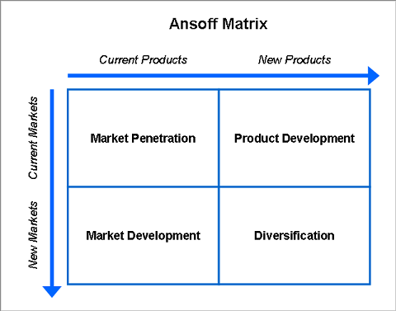
Competitive Position - Ansoff

Slide 26
Strategies
Continue to offer low-cost wine, maintaining higher margins than competitors.
Increase advertising in promising emerging markets (China, Russia, US, UK).
Acquire new companies in emerging markets.
Notes:
*Half the world market by volume.
*4 and a half times more expensive to harvest in US and France, almost twice as expensive to harvest in Australia. Australia could land its bulk table wine in the US at $0.80 a liter, Argentina’s price was $0.36 a liter.
*While other countries move from basic wine segment to premium and super-premium to improve their cost to profit margins, South American wineries will gain higher market share.
*Emphasis on China and Russia experiencing huge growth in consumption and also US and UK .
*Acquiring brands that people in that country will already be accustomed to. This approach will help South American wine companies break in to new markets and be successful.

Slide 27

United States
What is the United States ideal competitive position
and what strategies lend to optimal
performance?

Slide 28
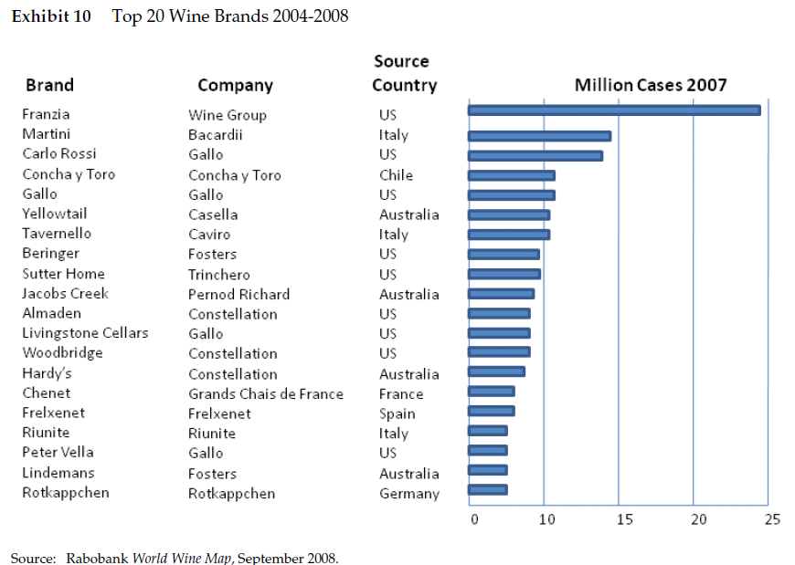
Notes:
The United States dominates the Top 20 Wine Brands by having a total of 9 brands in this rank, followed by Australia with only four of the Top 20.

Slide 29
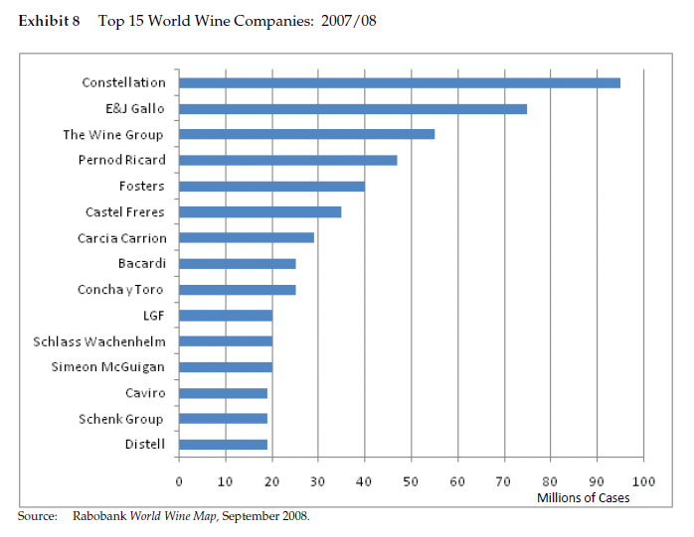
Notes:
The United States controls the top three spots in the Top 15 World Wine Companies, having four companies in the top five.

Slide 30
United States Wines PESTEL Analysis
 | Opportunities | Importance | Threats | Importance
Political | N/A |  | N/A
Economical | “Most attractive wine market in the world” | High | Extremely high land costs in US High labor costs | High Moderate
Social | Wine consumption increase Demand for higher premiums in US market | High High | Higher demand for imported wine | High
Technological | Advanced technology over Old World | Moderate | Old World slowly allowing for technology advancements | Low
Environmental | Large vineyards | Moderate | Lack of available land in premium areas | Moderate
Legal | N/A |  | Illegal immigration control (higher labor costs) 2005 US Supreme Court ruling triggered a series of state and federal regulation challenges that began to open up the US distribution system. | Low High

Slide 31
SWOT Analysis
Strengths | Weaknesses
Top three in World Wine Companies Nine brands in the Top 20, claiming the number one spot Posses large amount of land on average (213 hectares) Distribution expertise knowledge | Higher prices on similar rated Australian wines Global price/quality ratio Not able to capture the “home” market Lack of available premium land for expansion
Opportunities | Threats
Increased demand for premium based wines Increased wine consumption Generation Y (overall increased demand) Demand in Asia, Russia, Canada for wine consumption rising | Weather/Droughts High demand for imported wines Inflation Surplus (“Two Buck Chuck”) Old World acquiring new technology Wine producing countries with low labor costs and fertile land.

Slide 32
Ansoff Matrix
Notes:
Market Penetration - The United States needs to focus on Market Penetration within their borders; to increase sales and demand for domestic rather than imported wines.
Product Development - With Generation Y demanding premium lower cost wines there needs to be a form of product development to reach out to this competitive market that the imports are dominating.
Product Development – The United States is focusing on Product Development to enter into the premium wine market. Since the United States already excels in super and ultra premium brands as well as basic brands, they are now trying to compete with the Australian market in the premium wines.
Market Penetration – The United States need to focus on penetrating their own home market to sway customers to purchase domestic wines rather than imports.

Slide 33
Recommendations
Continue with the super and ultra premium brands, as they contribute to the growing 15% market share and are currently successful.
Premium brands account for a growing 30% of the market, which the United States is lacking. Focus on product development, coming up with a premium brand that is at a comparable cost with imports will attract more customers and increase sales.
Increase advertising and promotions in the United States to attract to more Generation Y customers who are typically buying imported wines.
Notes:
65% of US customers have admitted to not knowing what type/brand of wine they will purchase when entering the store, focus on advertising and promoting to attract to these customers.

Slide 34

Australia
What is Australia’s ideal competitive position
and what strategies lend to optimal
performance?

Slide 35
Australia’s Earlier Position
Australia was one of the late adopters toward New World’s opening markets.
Reasons:
Dominant British heritage made beer the alcoholic beverage of preference.
Lack of well established reputation
Wine consumer mostly by Old World immigrants
Post WWII saw Australia attempt to attract the global market.

Slide 36
Core Competency
Australia ‘s core competency is Innovation. Compared to competitors from New and Old wine companies, They have separated themselves by going against traditional ways.
In a mature market, this position of differentiation has proven to be a viable strategy for Australian wine makers.
Drip irrigation was not used until Australia utilized it on their land when growing the grapes used to make the wine. This created larger vineyards where innovative equipment was implemented to reduce the labor costs.
- “Wine in a box”
- Screw caps instead of cork screws
Notes:
Examples of Innovation have been
“Wine-in-a-box.” This pioneered the way wine could be packaged that resulted in reducing shipping costs.
Implementing irrigation systems
“Screw caps” instead of cork screws to preserve the Wine.

Slide 37
Australian Wines PESTEL Analysis
 | Opportunities | Importance | Threats | Importance
Political | Government linked up with Australian winemakers to develop strategy for continued growth of the industry. | High- Compared to US and France, Australia is given less regulations with their government. Strategy 2025, ensures government support at least until 2025 | N/A
Economical | Lower costs of land compared to US and France | High | Lower labor costs in South America and Asia. | Medium
Social | Wine consumption in increase Demand for higher premiums in US market | High | Consumption trending toward more price sensitive consumers minimizing Ultra and Super premium. | Moderate
Technological | N/A
Environmental | Sunny climates and irrigation system. | Moderate | Surpluses that lower costs overall on wine Droughts leading to major cost increases with water. | High
Legal | 2005 US Supreme Court ruling triggered a series of state and federal regulation challenges that began to open up the US distribution system. | Moderate | Stricter drinking laws throughout different countries. | Low

Slide 38
Comparison
 | France | Australia | US
Hectares | 7.4 | 167 | 213
Cost of pruning land | $350 | $120 | $350 (Cain Napa)
Brands in top 20(2004-2008) | 1 | 4(two in the top 10) | 9 ( Number 1 out of 20)
Generic Strategy | Narrow to a segment “Icon” that is differentiation. France has the traditional history to brand and promote the highest of classes in wine. However numbers show volume market share is 1% and Little growth | Broad Differentiation with product uniqueness. Australia’s 2025 plan wants to implement sub-brands that would target separate consumer groups. Australia should be recommended to NOT compete in low cost long term. | High cost producer. Differentiation and Narrow. General focus within Super and Ultra premium.
Government Involvement | EU agricultural policy changes leading to subsidizing marketing and promotion. Also, Regulation regions. | Governments wine export body linked with Fed. Of Australia to promote continued growth in the industry. | Illegal immigration affecting labor costs (Possible shortage?)
Notes:
Strategy 2025 was developed from Australian government looking to capitalize on the success.
Australia faces the least amount of barriers governmental wise compared to US and France.

Slide 39
Ultra and Super Premium Wine- Five Forces
Threat of new Entrants- Moderate Price of land and large capital investment. It can take 3-4 years on average to produce their first harvest. Time is also a major deterrent for new entry
Bargaining Buyer Power
High
Trends have impacted the industry such as Super, Ultra, or Premium quality and grape flavor.
Rivalry
High
Competition high between US, France and unknowns like Asia.
Suppliers Power Low There are vineyards and grape growers. Huge wine surpluses in the 2000’s allowed Australian producers to use their cost advantage, driving prices lower. This made Australian perception to be “Cheap”
Substitutes
Moderate
For Low or High premium costs, substitutes exist always as consumers may look to bourbon and whiskeys. Switching cost is moderate.
Notes:
Australia’s brand, “Yellow Tail. –Selling 10 million cases a year worldwide

Slide 40
SWOT Analysis
Internal
Strengths | Weaknesses
1.Leader in winemaking innovation 2. Strong distribution system 3. Responsible for “Wine-in-a-box” 4. typically sunnier climates allowing maximum wine producing 5. 60% of the worlds top wine companies | Not able to capture the highest class wine market. Australian Wine has been considered cheap and less pristine (due to Yellow Tails success as a low cost product.) Operational costs starting to rise.
External
Opportunities | Threats
Demand in Asia , Russia, Canada for wine consumption rising. US consumers preference for imports instead of domestic. Resources to break into the Premium-High premium market. Generation Y ( Gen. Y has more of a demand for wine compares to Gen. X) | Serious droughts ( weather) Changing drinking preferences Inflation in penetrating markets Old Country using same technology Major market in UK declining in consumption
Looking at the SWOT, it is fair to question should Australia’s competitive position continue be a low cost producer despite a demand for high premium wines? Exports in 2007 increased in the US to 31% but image perception was the wine is “Cheap.” Cost’s are rising and it is clear to have a better margin, low cost is not primarily recommended.
Notes:
Looking at the SWOT, it is fair to question should Australia’s competitive position continue be a low cost producer despite a demand for high premium wines? Exports in 2007 increased in the US to 31% but image perception was the wine is “Cheap.”
With the success of Yellow tail appealing to US consumers for price, image, and fruity content, Australia is not equipped long term, to be a major player in the Low Cost segment.

Slide 41
Ansoff Matrix
Brand “Pensfold” Red Wine range from Prem-Icon
Strategy 2025
Australia is positioning toward Product development to stay away from the “Cheap low cost” stigma they have carried.
Market Penetration in the US will be critical. US consumers prefer higher quality wines and US wine makers face much more expensive production costs related to land and labor. Product Development has been considered for the “Strategy 2025” plan that will appeal to 4 consumer groups with emphasis on innovation and design.
Notes:
Brand “Pensfold” Red Wine

Slide 42
Caution!
For Australia’s strategy, they must be mindful of two things:
1. South America’s low production cost’s allow them to have lower grape costs and production. (Further inclination, competing in Low cost is not wise)
2. US holds 9 spots in the worlds top 20 Brands (2004-2008)

Slide 43
Recommendations
Continue to stick with the Strategy 2025 plan. Data shows it has been successful in exports( grape and export production grew 530% to 782 million liters in 2006)
Reposition Australian wines as a premium for US Generation Y consumers. They prefer imports over domestic which is an advantage. US producers face higher production costs and France’s system doesn’t allow them to respond to consumer demand as quickly.
Continue with the innovation in brand, packaging, and image that allowed Australia to be a big player in the Wine industry. Studies showed 65% US consumers had no idea what they would choose when entering a wine store.
Look to emerging markets like Russia, and Canada. China has great growth potential, but may be more attractive toward a primary low cost producer.
Focus on Premium, Super, and Ultra. Combined they represent 49% volume market share. Consumer profile says these are “experimenters”
By using this competitive positioning Australia should be able to capture 1% of the global market by 2025!
Notes:
US market increased from 11 billion to a 30 billion dollar market in 2007. 48% represented the Premium market while growing at 15% p.a.
Australia is prideful of their innovation to wine making and packaging. The Ultra, Super and premium show they are Experimenters which goes perfect with Innovation emphasis.

Slide 44
Questions?

